Slide 1

HNDIT2417
Mobile Application Development
www.hndit.com
Week1&2- Introduction to Mobile Application Development & Android Studio

Slide 2
Outline
www.hndit.com
Introduction to Android Application Framework

Slide 3
Application Framework
www.hndit.com
The Application Framework is a set of services that collectively form the environment in which Android applications run and are managed. This framework implements the concept that Android applications are constructed from reusable, interchangeable and replaceable components.

Slide 4
The Android framework includes the following key services:
www.hndit.com
Activity Manager – Controls all aspects of the application lifecycle and activity stack.
Content Providers – Allows applications to publish and share data with other applications.
Resource Manager – Provides access to non-code embedded resources such as strings, color settings and user interface layouts.
Notifications Manager – Allows applications to display alerts and notifications to the user.
View System – An extensible set of views used to create application user interfaces.
Package Manager – The system by which applications are able to find out information about other applications currently installed on the device.
Telephony Manager – Provides information to the application about the telelphoney services available on the device such as status and subscriber information.
Location Manager – Provides access to the location services allowing an application to receive updates about location changes.

Slide 5
Applications
www.hndit.com
Located at the top of the Android software stack are the applications. These comprise both the native applications provided with the particular Android implementation (for example web browser and email applications) and the third party applications installed by the user after purchasing the device.

Slide 6
The Anatomy of an Android Studio Android Application
www.hndit.com
Android Activities: Android applications are created by bringing together one or more components known as Activities. An activity is a single, standalone module of application functionality that usually correlates directly to a single user interface screen and its corresponding functionality.

Slide 7
www.hndit.com
Android Intents : Intents are the mechanism by which one activity is able to launch another and implement the flow through the activities that make up an application. Intents consist of a description of the operation to be performed and, optionally, the data on which it is to be performed. Intents can be explicit, in that they request the launch of a specific activity by referencing the activity by class name, or implicit by stating either the type of action to be performed or providing data of a specific type on which the action is to be performed.

Slide 8
www.hndit.com
Broadcast Intents: Another type of Intent, the Broadcast Intent, is a system wide intent that is sent out to all applications that have registered an “interested” Broadcast Receiver. The Android system, for example, will typically send out Broadcast Intents to indicate changes in device status such as the completion of system start up, connection of an external power source to the device or the screen being turned on or off.

Slide 9
www.hndit.com
Broadcast Receivers: Broadcast Receivers are the mechanism by which applications are able to respond to Broadcast Intents. A Broadcast Receiver must be registered by an application and configured with an Intent Filter to indicate the types of broadcast in which it is interested. When a matching intent is broadcast, the receiver will be invoked by the Android runtime regardless of whether the application that registered the receiver is currently running. The receiver then has 5 seconds in which to complete any tasks required of it (such as launching a Service, making data updates or issuing a notification to the user) before returning. Broadcast Receivers operate in the background and do not have a user interface.

Slide 10
www.hndit.com
Android Services : Android Services are processes that run in the background and do not have a user interface. They can be started and subsequently managed from activities, Broadcast Receivers or other Services. Android Services are ideal for situations where an application needs to continue performing tasks but does not necessarily need a user interface to be visible to the user.

Slide 11
www.hndit.com
Content Providers : Content Providers implement a mechanism for the sharing of data between applications. Any application can provide other applications with access to its underlying data through the implementation of a Content Provider including the ability to add, remove and query the data (subject to permissions). Access to the data is provided via a Universal Resource Identifier (URI) defined by the Content Provider. Data can be shared in the form of a file or an entire SQLite database.

Slide 12
www.hndit.com
The Application Manifest: The glue that pulls together the various elements that comprise an application is the Application Manifest file. It is within this XML based file that the application outlines the activities, services, broadcast receivers, data providers and permissions that make up the complete application.

Slide 13
www.hndit.com
Application Resources : In addition to the manifest file and the Dex files that contain the byte code, an Android application package will also typically contain a collection of resource files. These files contain resources such as the strings, images, fonts and colors that appear in the user interface together with the XML representation of the user interface layouts. By default, these files are stored in the /res sub-directory of the application project’s hierarchy.

Slide 14
www.hndit.com
Application Context: When an application is compiled, a class named R is created that contains references to the application resources. The application manifest file and these resources combine to create what is known as the Application Context. This context, represented by the Android Context class, may be used in the application code to gain access to the application resources at runtime.

Slide 15
Activity Lifecycles
www.hndit.com
The activities is transition through different states during the execution lifetime of an application. The current state of an activity is determined, in part, by its position in something called the Activity Stack.

Slide 16
The Activity Stack
www.hndit.com
For each application that is running on an Android device, the runtime system maintains an Activity Stack. When an application is launched, the first of the application’s activities to be started is placed onto the stack. When a second activity is started, it is placed on the top of the stack and the previous activity is pushed down. The activity at the top of the stack is referred to as the active (or running) activity. When the active activity exits, it is popped off the stack by the runtime and the activity located immediately beneath it in the stack becomes the current active activity. The activity at the top of the stack might, for example, simply exit because the task for which it is responsible has been completed. Alternatively, the user may have selected a “Back” button on the screen to return to the previous activity, causing the current activity to be popped off the stack by the runtime system and therefore destroyed

Slide 17
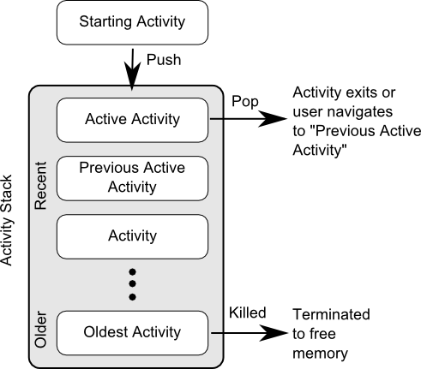
www.hndit.com

Slide 18
Activity States
www.hndit.com
Active / Running – The activity is at the top of the Activity Stack, is the foreground task visible on the device screen, has focus and is currently interacting with the user. This is the least likely activity to be terminated in the event of a resource shortage.
Paused – The activity is visible to the user but does not currently have focus (typically because this activity is partially obscured by the current active activity). Paused activities are held in memory, remain attached to the window manager, retain all state information and can quickly be restored to active status when moved to the top of the Activity Stack.
Stopped – The activity is currently not visible to the user (in other words it is totally obscured on the device display by other activities). As with paused activities, it retains all state and member information, but is at higher risk of termination in low memory situations.
Killed – The Activity has been terminated by the runtime system in order to free up memory and is no longer present on the Activity Stack. Such activities must be restarted if required by the application.

Slide 19
The Android Activity Lifecycle Methods
www.hndit.com
onCreate(Bundle savedInstanceState) – The method that is called when the activity is first created and the ideal location for most initialization tasks to be performed. The method is passed an argument in the form of a Bundle object that may contain dynamic state information (typically relating to the state of the user interface) from a prior invocation of the activity.
onRestart() – Called when the activity is about to restart after having previously been stopped by the runtime system.
onStart() – Always called immediately after the call to the onCreate() or onRestart() methods, this method indicates to the activity that it is about to become visible to the user. This call will be followed by a call to onResume() if the activity moves to the top of the activity stack, or onStop() in the event that it is pushed down the stack by another activity.
onResume() – Indicates that the activity is now at the top of the activity stack and is the activity with which the user is currently interacting.

Slide 20
The Android Activity Lifecycle Methods….
www.hndit.com
onPause() – Indicates that a previous activity is about to become the foreground activity. This call will be followed by a call to either the onResume() or onStop() method depending on whether the activity moves back to the foreground or becomes invisible to the user. Steps should be taken within this method to store any persistent data required by the activity (such as data stored to a content provider, database or file). This method should also ensure that any CPU intensive tasks such as animation are stopped.
onStop() – The activity is now no longer visible to the user. The two possible scenarios that may follow this call are a call to onRestart() in the event that the activity moves to the foreground again, or onDestroy() if the activity is being terminated.
onDestroy() – The activity is about to be destroyed, either voluntarily because the activity has completed its tasks and has called the finish() method or because the runtime is terminating it either to release memory or due to a configuration change (such as the orientation of the device changing). It is important to note that a call will not always be made to onDestroy() when an activity is terminated.

Slide 21
Activity Lifetimes
www.hndit.com
Entire Lifetime – The term “entire lifetime” is used to describe everything that takes place within an activity between the initial call to the onCreate() method and the call to onDestroy() prior to the activity terminating.
Visible Lifetime – Covers the periods of execution of an activity between the call to onStart() and onStop(). During this period the activity is visible to the user though may not be the activity with which the user is currently interacting.
Foreground Lifetime – Refers to the periods of execution between calls to the onResume()and onPause() methods.

Slide 22
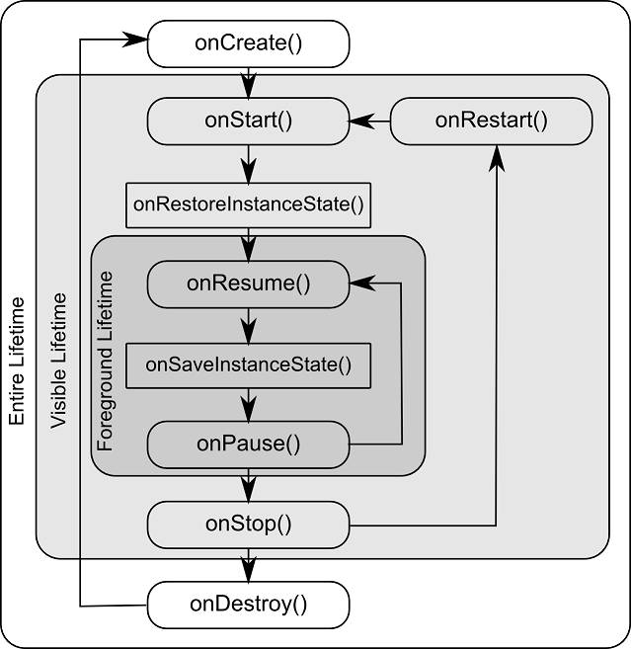
www.hndit.com

Slide 23
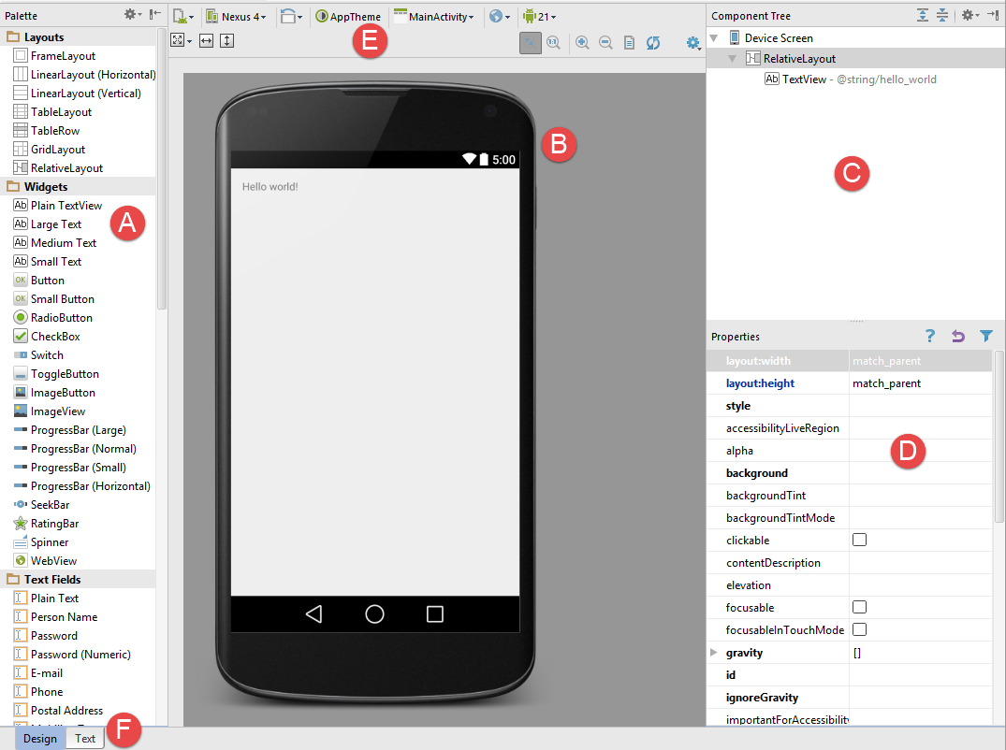
Android Studio Environment
www.hndit.com
A – Palette
B – Device Screen
C – Component Tree
D – Properties
E – Toolbar
F – Mode Switching Tabs

Slide 24
Editing View Properties
www.hndit.com
in – Inches
mm – Millimeters
pt – Points (1/72 of an inch)
dp – Density-independent pixels. An abstract unit of measurement based on the physical density of the device display relative to a 160dpi display baseline.
sp – Scale-independent pixels. Similar to dp but scaled based on the user’s font preference.
px – Actual screen pixels. Use is not recommended since different displays will have different pixels per inch. Use dp in preference to this unit.

